Slide 1

Time-Domain Methods for Speech Processing

Slide 2
Contents
Short-Time Analysis of Speech
Short-Time Energy and Short-Time Magnitude
Short-Time Zero-Crossing Rate
The Short-Time Autocorrelation Function
The Modified Short-Time Autocorrelation Function
The Short-Time Average Magnitude Difference Function

Slide 3
Short-Time Analysis of Speech

Slide 4
Short-Time Analysis of Speech
Introduction to time-domain methods for analyzing speech signals
Time-domain methods directly analyze speech signals in the time dimension without converting them into frequency components. Key techniques include:
Waveform Representation: Speech signals are represented as waveforms showing amplitude variations over time.
Segmentation: Identifying boundaries between phonetic units (e.g., phonemes, syllables) based on signal characteristics.
Time-domain Features: This method extracts features like amplitude, zero-crossing rate, energy, and pitch directly from the signal.
Windowing and Framing: Analyzing speech in short-time windows using window functions (e.g., Hamming) for localized analysis.
Time-domain Filtering: This involves applying filters (e.g., low-pass, high-pass) directly to the speech signal to reduce or enhance noise.
Time-domain Processing: Techniques like time-warping, time scaling, and pitch modification to alter speech characteristics.
Speech Recognition and Synthesis: Basis for speech recognition and synthesis systems by analyzing temporal speech patterns.

Slide 5
Short-Time Analysis of Speech
Speech Signal Characteristics
Speech signals are time-varying waveforms produced by the vocal tract.
Key components of speech include phonemes (distinct sounds), prosody (intonation, rhythm), and non-stationary characteristics.
Time-domain representation: Waveform plot showing amplitude variation over time.

Slide 6
Short-Time Analysis of Speech
Short-Time Analysis
Short-time analysis is a fundamental technique used in signal processing, particularly in analyzing time-varying signals like speech.
It involves breaking down a continuous signal into short segments or frames and analyzing each segment separately.
Windowing: Apply a window function (e.g., Hamming) to each frame to taper the signal's edges, reducing spectral leakage during analysis.
Segmentation into Frames: Divide the signal into overlapping or non-overlapping frames of fixed duration to capture temporal dynamics.
Time-Domain Analysis: Extract features (e.g., amplitude, energy, pitch) from each frame to understand how signal characteristics change over time.
Frequency-Domain Analysis: Optionally, transform each frame into the frequency domain using FFT to analyze frequency components.

Slide 7
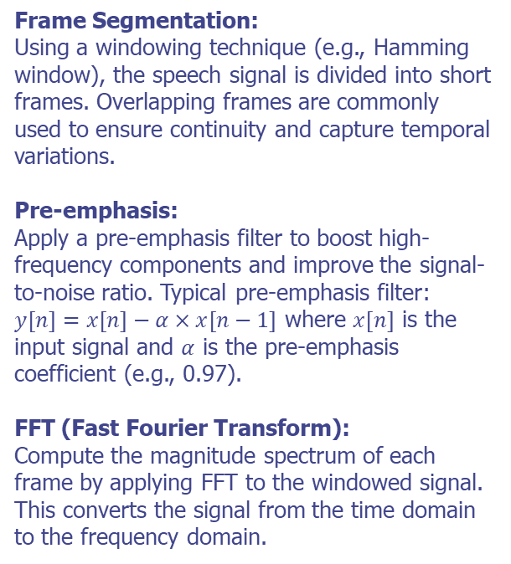
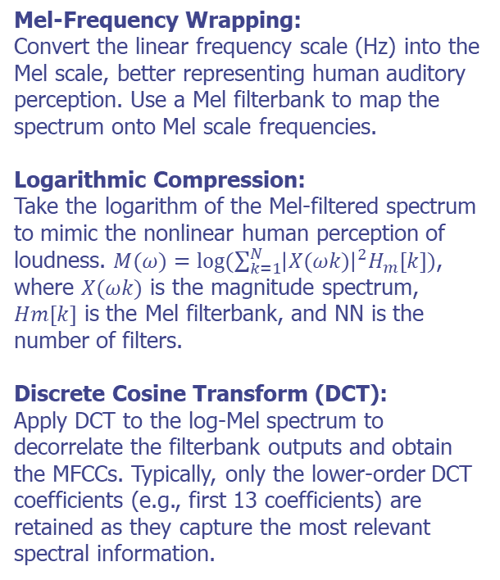
Short-Time Analysis of Speech
Steps to Compute MFCCs

Slide 8
Short-Time Analysis of Speech
Practical Assignment
Task: Implement short-time analysis techniques on a speech dataset.
Dataset: Provide a sample speech dataset containing multiple audio files.
Steps:
Load speech audio files and preprocess using Librosa.
Compute and visualize spectrograms for each speech signal.
Extract MFCC features from the spectrograms.
Perform basic speech classification using MFCCs (e.g., distinguishing different speakers or speech vs. non-speech).

Slide 9
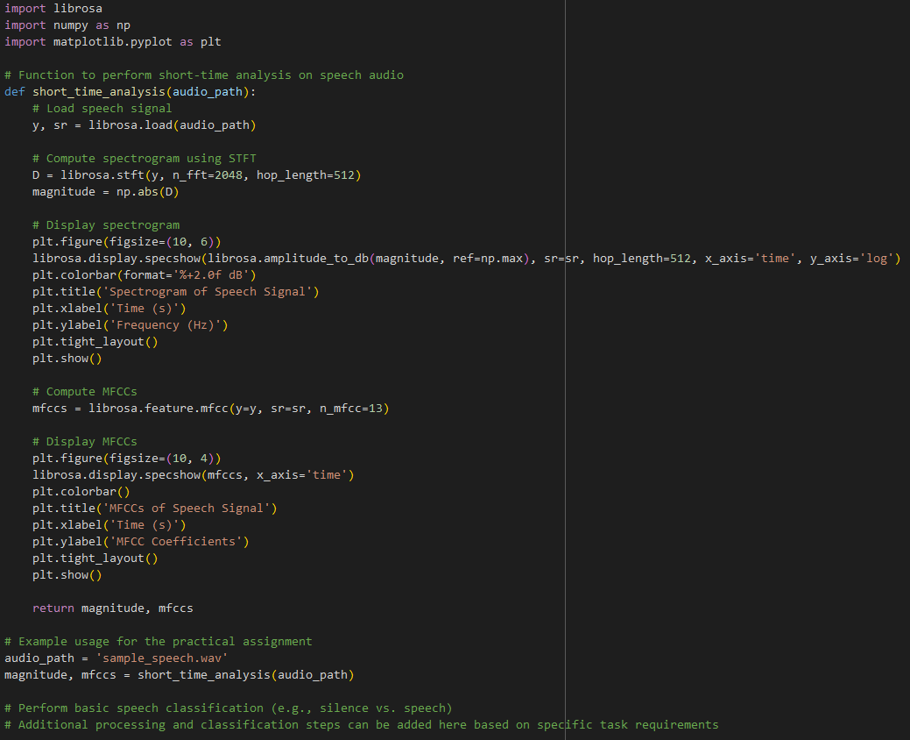
Short-Time Analysis of Speech
Practical Assignment (Solution)

Slide 10
Short-Time Energy and Short-Time Magnitude

Slide 11
Short-Time Energy and Short-Time Magnitude
Introduction
Short-Time Energy (STE) and Short-Time Magnitude (STM) are fundamental time-domain features in speech processing, providing valuable insights into the temporal characteristics of speech signals.
Their ability to capture energy and amplitude variations makes them indispensable in various speech-processing applications, from voice activity detection to speaker recognition.
Understanding and effectively utilizing these features are essential for advancing speech technology.

Slide 12
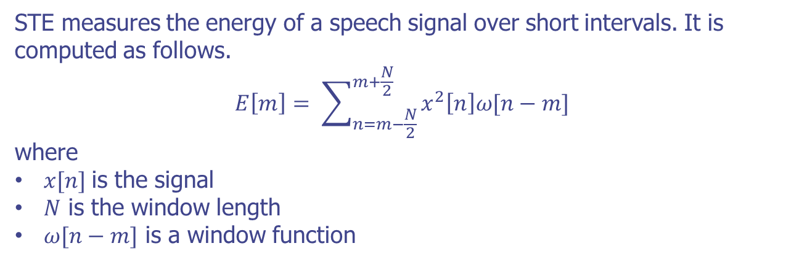
Short-Time Energy and Short-Time Magnitude
Definition and Calculation of Short-Time Energy (STE)

Slide 13
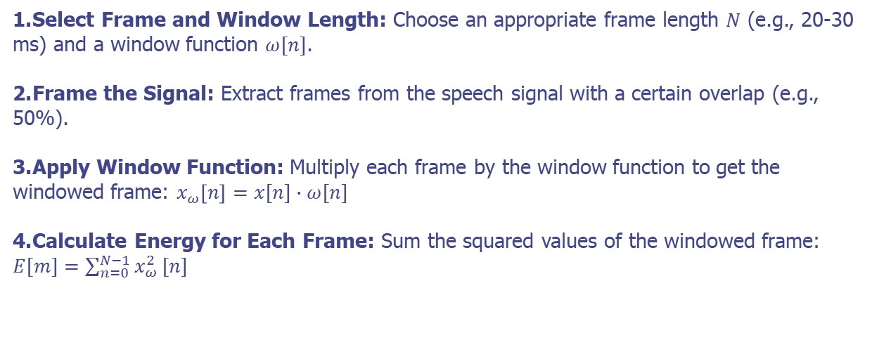
Short-Time Energy and Short-Time Magnitude
Definition and Calculation of Short-Time Energy (STE)
The speech signal is divided into short, overlapping frames to compute STE. The energy within each frame is then calculated. Here’s the step-by-step process.

Slide 14
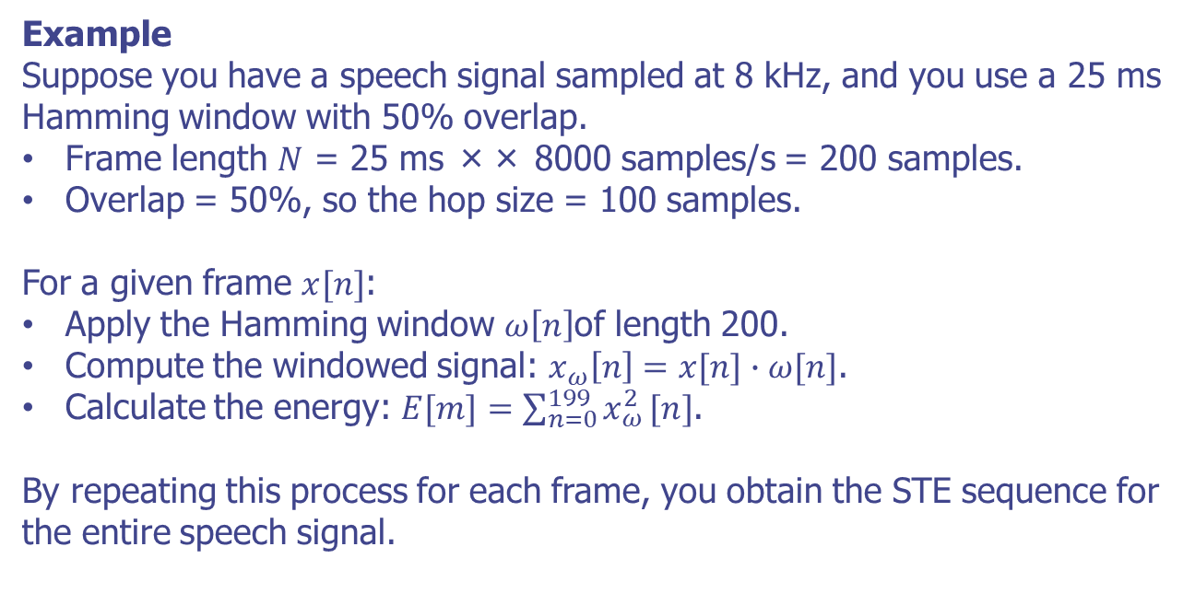
Short-Time Energy and Short-Time Magnitude
Definition and Calculation of Short-Time Energy (STE)

Slide 15
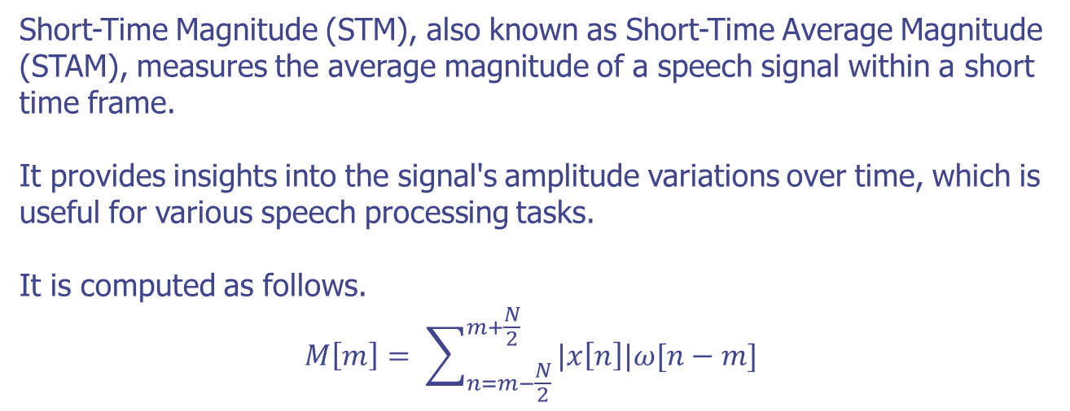
Short-Time Energy and Short-Time Magnitude
Definition and Calculation of Short-Time Magnitude (STM)

Slide 16
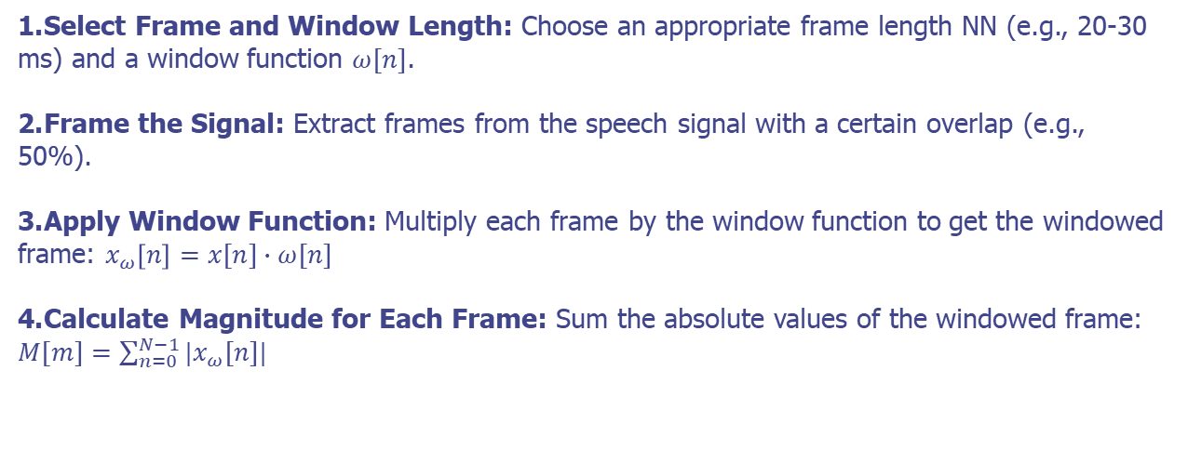
Short-Time Energy and Short-Time Magnitude
Definition and Calculation of Short-Time Magnitude (STM)
The speech signal is divided into short, overlapping frames to compute STM, and the average magnitude of the signal within each frame is calculated. Here’s the step-by-step process

Slide 17

Short-Time Energy and Short-Time Magnitude
Definition and Calculation of Short-Time Energy (STE)

Slide 18
Short-Time Energy and Short-Time Magnitude
Practical Assigments
Task: Implement short-time energy and magnitude analysis on a speech dataset.
Dataset: Sample speech dataset with multiple audio files (URL).
Steps:
Load speech audio files and preprocess using Librosa.
Compute short-time energy and magnitude for each frame.
Visualize energy and magnitude variations over time.
Apply basic speech activity detection using energy thresholds.
Goal: Understand the application of STE and STM in speech processing tasks.

Slide 19
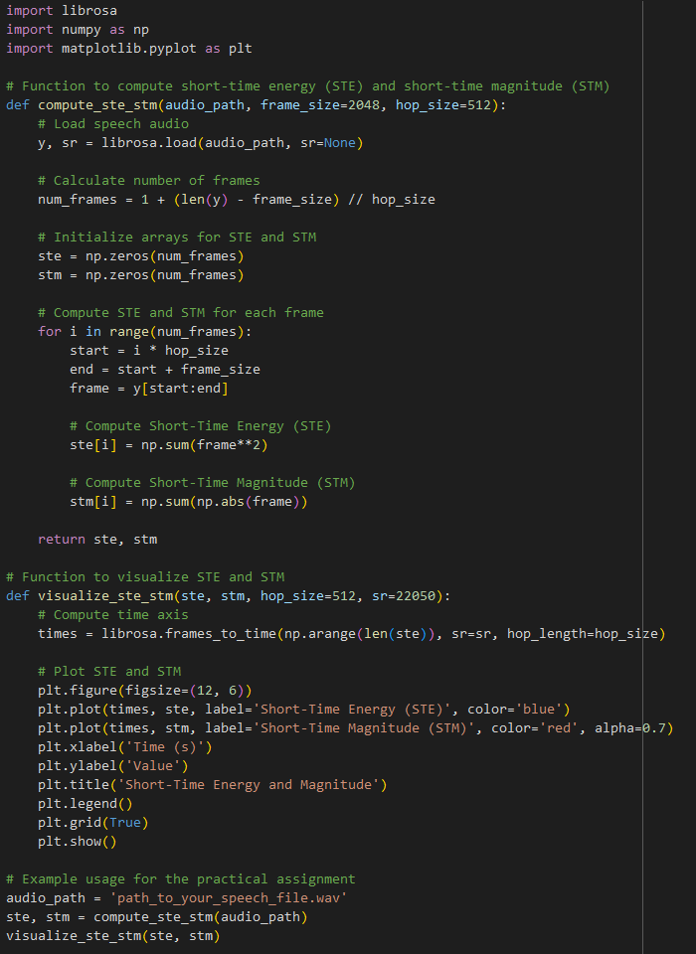
Short-Time Energy and Short-Time Magnitude
Practical Assignments (solution)

Slide 20
Short-Time Zero-Crossing Rate

Slide 21
Short-Time Zero-Crossing Rate
Introduction
Short-Time Zero-Crossing Rate (ZCR) measures how frequently the signal amplitude crosses the zero axis within a short time frame.
It indicates the rate of sign changes in the signal, providing insights into the signal's frequency content and characteristics

Slide 22
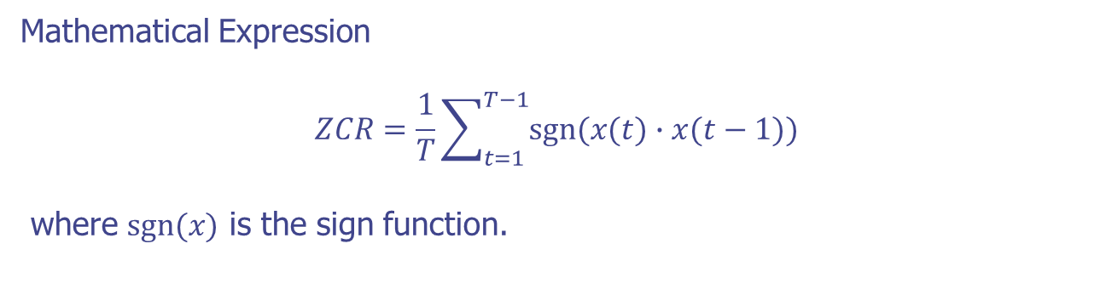
Short-Time Zero-Crossing Rate
Zero-Crossing Rate
Definition of Zero-Crossing Rate (ZCR)
The rate at which the signal changes sign (crosses zero) in a given time frame.
Reflects the frequency content of the signal in the time domain.

Slide 23
Short-Time Zero-Crossing Rate
Importance of ZCR in Speech Processing
Why ZCR Matters
High ZCR indicates high-frequency content (e.g., fricatives).
Low ZCR indicates low-frequency content (e.g., vowels).
Useful for distinguishing between voiced and unvoiced speech segments.

Slide 24
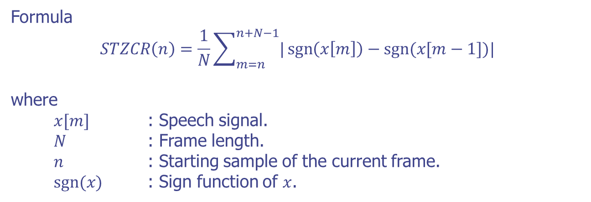
Short-Time Zero-Crossing Rate
Short-Time Zero-Crossing Rate (STZCR)

Slide 25
Short-Time Zero-Crossing Rate
Practice Assigment
Libraries
Use of Librosa and NumPy for signal processing.
Code Examples
Loading a speech audio file.
Computing short-time zero-crossing rate.
Visualization of ZCR over time.

Slide 26
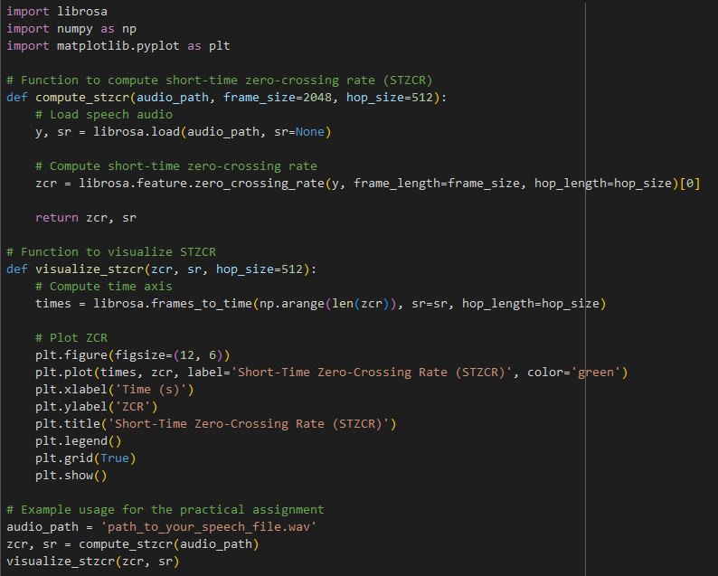
Short-Time Zero-Crossing Rate
Practice Assigment (Solution)

Slide 27
The Short-Time Autocorrelation Function

Slide 28
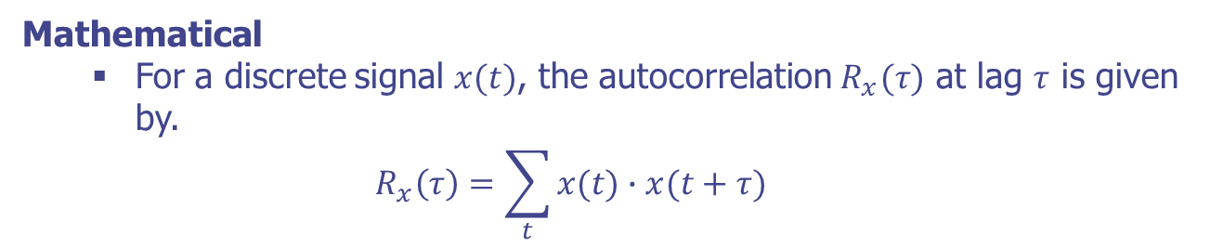
The Short-Time Autocorrelation Function
Autocorrelation
Definition
Autocorrelation measures the similarity between a signal and a delayed version of itself as a function of the delay.
Useful for detecting repeating patterns or periodic signals within a signal.

Slide 29
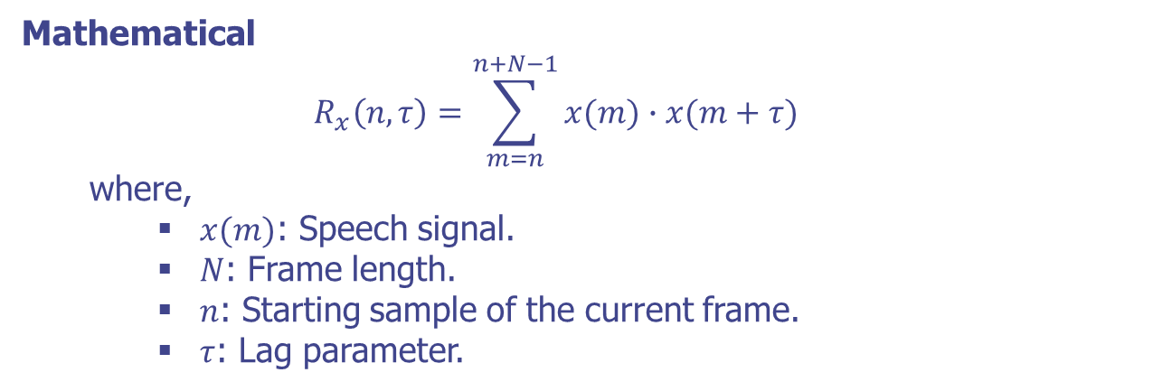
The Short-Time Autocorrelation Function
Short-Time Autocorrelation Function (STACF)
Definition
The STACF captures the local periodicity within short frames of the signal.

Slide 30
The Short-Time Autocorrelation Function
Applications of STACF in Speech Processing
Applications
Pitch Detection: Using peaks in STACF to determine the fundamental frequency.
Voiced/Unvoiced Detection: Analyzing periodicity to differentiate between voiced and unvoiced sounds.
Speech Analysis and Synthesis: Enhancing coding efficiency and improving synthetic speech quality.
Examples
Real-world applications where STACF is effectively used, such as in speech recognition systems and voice activity detection.

Slide 31
The Short-Time Autocorrelation Function
Practical Assignment
Task: Implement short-time autocorrelation function analysis on a speech dataset.
Dataset: Sample speech dataset with multiple audio files (URL).
Steps:
Load speech audio files and preprocess using Librosa.
Compute short-time autocorrelation function for each frame.
Visualize STACF variations over time.
Apply basic pitch detection using STACF.

Slide 32
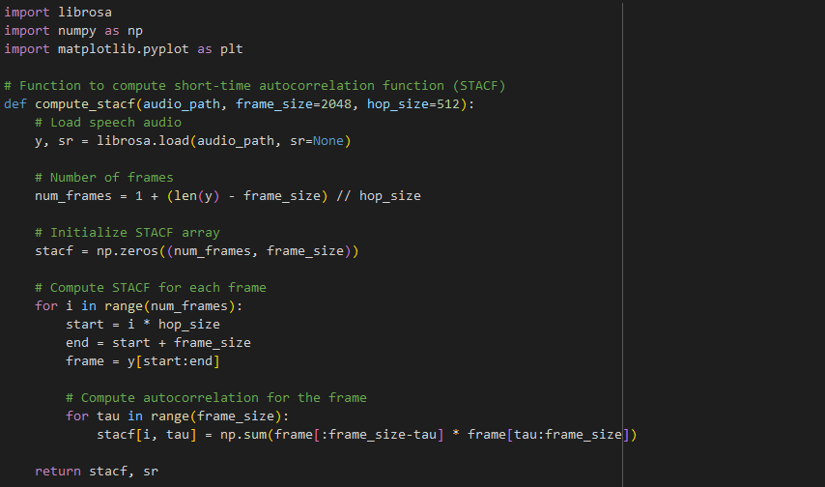
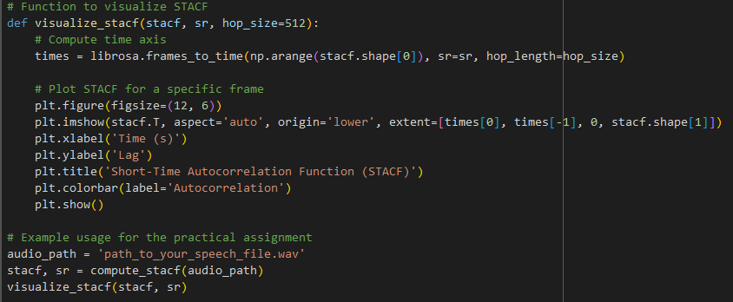
The Short-Time Autocorrelation Function
Practical Assignment (Solution)

Slide 33
The Short-Time Autocorrelation Function
Summary
The short-time autocorrelation function is a valuable time-domain feature for speech processing.
Python libraries like Librosa facilitate the practical implementation of STACF analysis.
Future directions and applications of STACF in various speech processing tasks, including advanced pitch detection and speech synthesis.

Slide 34
The Modified Short-Time Autocorrelation Function

Slide 35
The Modified Short-Time Autocorrelation Function
Introduction
MSTACF enhances the standard STACF by applying a windowing function to the signal and its delayed version before computing the product.
This modification helps analyze speech signals better by reducing noise and emphasizing significant components.

Slide 36
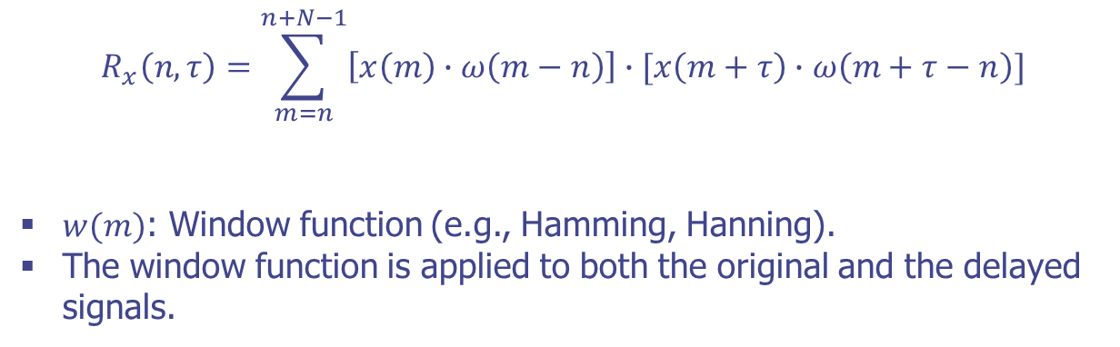
The Modified Short-Time Autocorrelation Function
Formulation

Slide 37
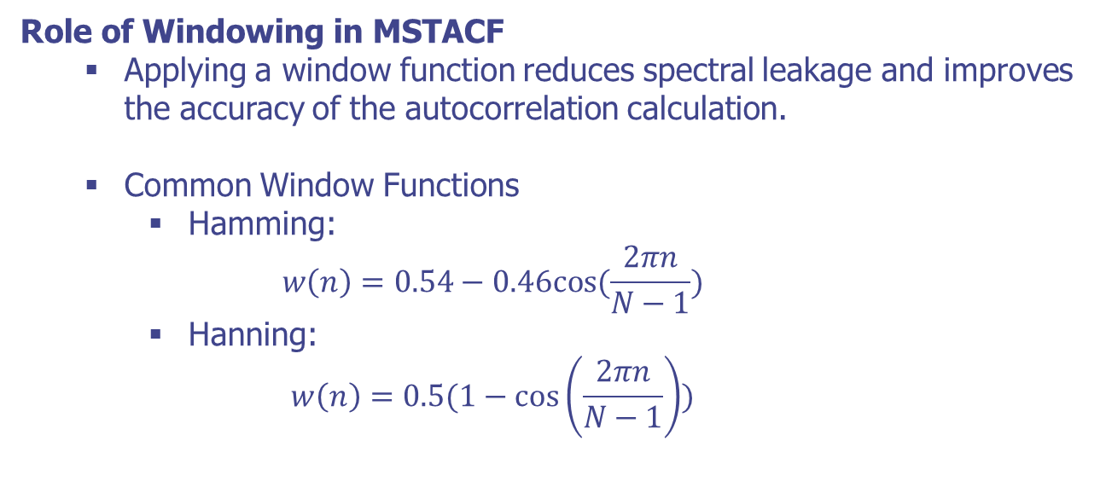
The Modified Short-Time Autocorrelation Function
Windowing and Its Importance

Slide 38
The Modified Short-Time Autocorrelation Function
Practical Assigment
Task: Implement modified short-time autocorrelation function analysis on a speech dataset.
Dataset: Sample speech dataset with multiple audio files (URL).
Steps:
Load speech audio files and preprocess using Librosa.
Compute modified short-time autocorrelation function for each frame.
Visualize MSTACF variations over time.
Apply basic pitch detection using MSTACF.

Slide 39
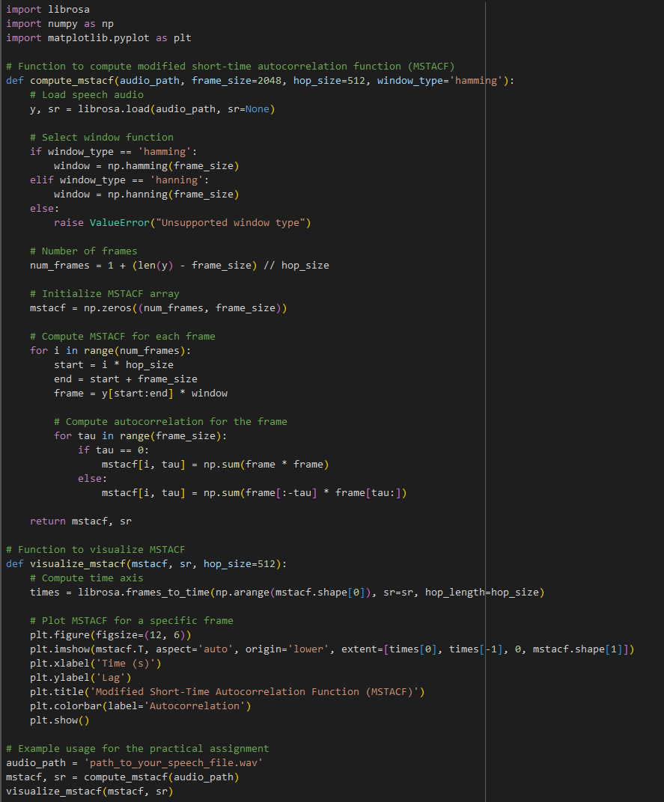
The Modified Short-Time Autocorrelation Function
Practical Assigment (Solution)

Slide 40
The Modified Short-Time Autocorrelation Function
Summary
The modified short-time autocorrelation function (MSTACF) is a valuable enhancement of STACF for speech processing.
Python libraries like Librosa facilitate the practical implementation of MSTACF analysis.
Future directions and applications of MSTACF in various speech processing tasks, including advanced pitch detection, noise-robust speech recognition, and speech enhancement.

Slide 41
The Short-Time Average Magnitude Difference Function

Slide 42
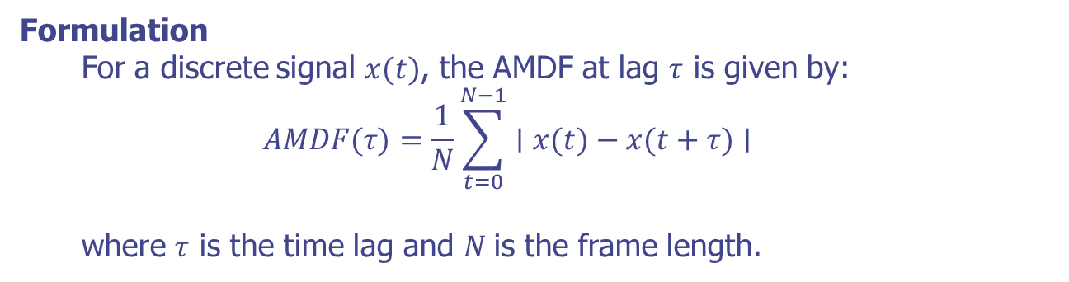
The Short-Time Average Magnitude Difference Function
Average Magnitude Difference Function (AMDF)
Definition
The Average Magnitude Difference Function measures the average absolute difference between a signal and its delayed version.
Useful for detecting periodicity and fundamental frequencies in a signal.

Slide 43
The Short-Time Average Magnitude Difference Function
Importance of AMDF in Speech Processing
Pitch Detection: Identifying the fundamental frequency of voiced speech.
Speech Segmentation: Differentiating between voiced and unvoiced speech segments.
Pattern Recognition: Recognizing periodic structures within the speech signal.

Slide 44
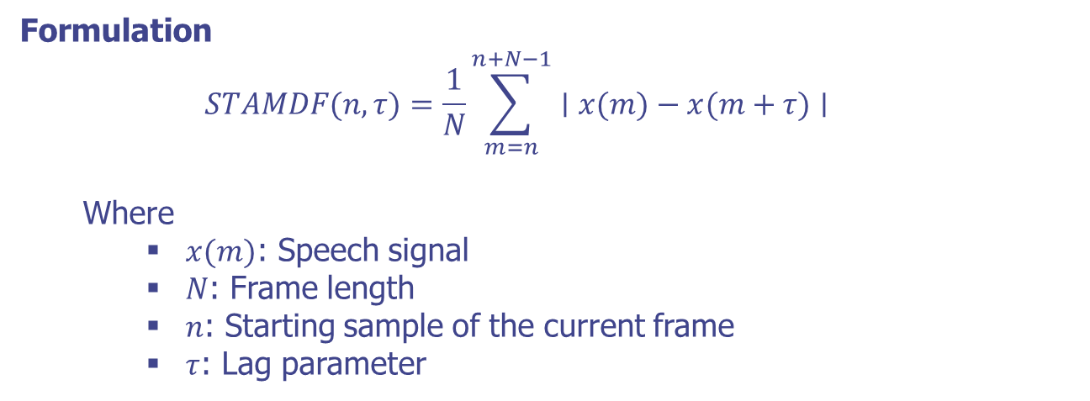
The Short-Time Average Magnitude Difference Function
Short-Time Average Magnitude Difference Function (STAMDF)
Definition
The STAMDF captures the local periodicity within short frames of the signal.

Slide 45
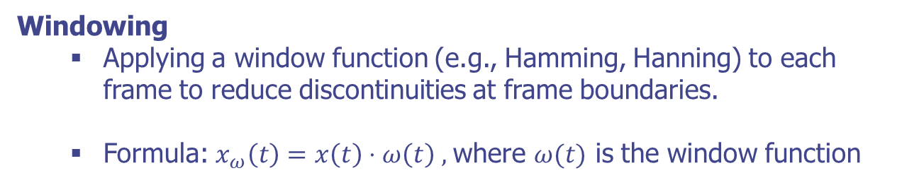
The Short-Time Average Magnitude Difference Function
Windowing and Framing
Framing
Segmenting the speech signal into overlapping frames.
Parameters include frame size (N) and frameshift (hop size).

Slide 46
The Short-Time Average Magnitude Difference Function
Practical Assignment
Task: Implement short-time average magnitude difference function analysis on a speech dataset.
Dataset: Sample speech dataset with multiple audio files.
Steps:
Load speech audio files and preprocess using Librosa.
Compute short-time average magnitude difference function for each frame.
Visualize STAMDF variations over time.
Apply basic pitch detection using STAMDF.

Slide 47
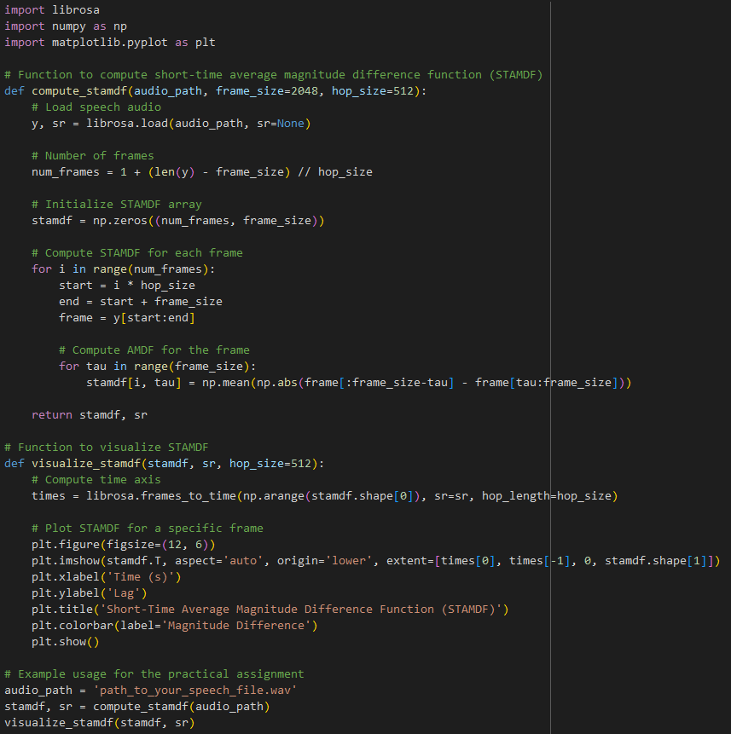
The Short-Time Average Magnitude Difference Function
Practical Assignment (Solution)

Slide 48
The Short-Time Average Magnitude Difference Function
Summary
The short-time average magnitude difference function (STAMDF) is a valuable time-domain feature for speech processing.
Python libraries like Librosa facilitate practical implementation of STAMDF analysis.
Future directions and applications of STAMDF in various speech processing tasks, including advanced pitch detection and speech synthesis.

Slide 49
Q & A

